Slide 1
Linux Shell Commands
ＨＧＵ

Slide 2
Shell
사용자와 Kernel 간의 Interface program
사용자 명령을 해석하여 Kernel에서 수행하도록 하고
명령실행 결과를 사용자에게 출력
Shell
Kernel
HW

Slide 3
Shell의 시작과 종료
Login 시 shell 자동 실행
Logout (exit 명령이나 키보드 ^D 입력) 전까지 shell은 사용자 명령어 입력,해석, 실행 반복
Shell 초기화 (.profile, .bashrc)
Prompt 출력 및
사용자 입력 대기
사용자 명령
실행
exit or ^D
종료

Slide 4
Shell의 작동
start
Display prompt
Read command
decode command
Execute command
Internal command?
Y
Create child process
$ <command> ↲
<response by shell>
$ (prompt)
Parent shell waits for child process
program exec by kernel in child process
Y
Child finished?
child process exits

Slide 5
User Command sequence
각 명령어는 세미콜론 (;) 으로 구분하여 다수의 명령어 한줄에 입력 가능
한번에 하나의 명령어 실행
Ex) $ clear ; pwd; ls

Slide 6
사용자 프로그램의 실행
Exec 시스템 call
C start up routine에게 command line arguments와 environments 전달
C start up routine
전달받은 인자를 실행 사용자 프로그램의 main() 함수에게 전달
main()의 종료시 return값을 받아서 exit 수행
Kernel:
Exec system call
User
process:
C startup routine
call
return
Int main(int argc char *argv[], char *envp[])

Slide 7
Command line arguments and environment vars
int main(int argc, char * argv[] , char * envp[])
argv 및 envp가 가리키는 배열의 마지막 원소 값은 NULL이어야 함
argv
argv[0]
argv[1]
…
argv[argc-1]
NULL
프로그램 이름
프로그램의 첫번째 인자
프로그램의 마지막 인자 = (argc-1)번째 인자
envp
envp[0]
envp[1]
…
envp[N-1]
NULL
“USER=yk”
“LOGNAME=yk”
“HOME=/user/yk”

Slide 8
Example code
#include <stdio.h>
int main (int argc, char *argv[], char *envp[])
{
printf(“** Command args **\n”);
for(int i=0;i<argc;i++)
printf(“%02d: %s\n”, I, argv[i]);
printf(“** Environment **\n”);
while (*envp)
printf(“%s\n”, *envp++);
return 0;
}
// or
for (int i=0; ; i++){
if(envp[i] == NULL) break;
printf(“%02d: %s\n”, i, envp[i]);
}

Slide 9
환경변수 값 개별 lookup
#include <stdlib.h>
char * getenv(const char *name);
// 환경변수 name의 값 반환,
// 해당 변수가 없으면 NULL 반환
#include <stdio.h>
int main (void)
{
char *val;
val = getenv(“HOME”);
printf(“HOME = %s\n”, val);
val = getenv(“SHELL”);
printf(“SHELL = %s\n”, val);
val = getenv(“PATH”);
printf(“PATH = %s\n”, val);
exit(0);
}

Slide 10
File Management Commands in Linux
ＨＧＵ

Slide 11
Normal Files
Normal files: a set of contiguous data addressed with one name
This includes all the files normally expected under this term (such as ASCII texts, executable programs, or graphics files)
You can use any names you want for these files—there is no division into filename and file type
A number of filenames still retain this structure, but these are requirements of the corresponding applications, such as a word processing program or a compiler

Slide 12
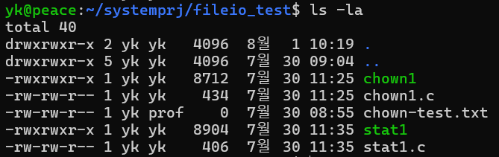
Directories
Directories store both special and ordinary files. For users familiar with Windows or iOS, UNIX directories are equivalent to folders
two entries with which the structure of the hierarchical file system is implemented
One of these entries (“.”) points to the directory itself
The other entry (“..”) points to the entry one level higher in the hierarchy

Slide 13
Device Files
Each piece of hardware (with the exception of network cards) in a Linux system is represented by a device file
These files represent links between the hardware components or the device drivers in the kernel and the applications
Every program that wants to access hardware must access it through the corresponding device file
The programs write to or read from a device file
The kernel then ensures that the data finds its way to the hardware or can be read from the file

Slide 14
Links
Links are references to files located at other points in the file system
Data maintenance is simplified through the use of such links
Changes only need to be made to the original file
The changes are then automatically valid for all links
Symbolic Link : is used for referencing some other file of the file system. Symbolic link is also known as Soft link

Slide 15
Inter-process communication: Sockets, Pipes, and FIFOs
A Socket: Two processes on the same machine of different machine over network through socket
created by socket() system call
requires IP address and port binding to each socket
Pipes : A unidirectional communication channel between two processes. A simple way to send a data from one process to another
created by pipe() system call
shell pipe ((ex) $ ls | grep txt), unidirectional IPC
FIFO (named pipe): A bidirectional communication between multiple unrelated processes in the filesystem (FIFO appears as a file in a filesystem e.g. /tmp/my_fifo).
created by mkfifo() or mknod() system call
bidirectional IPC between multiple processes

Slide 16
Commands to Change Directories and List Directory Contents
The prompt of a shell terminal contains the current directory (such as tux@da10:~)
The tilde (~) indicates that you are in the user’s home directory
Commands:
cd <path>: change directory to <path>
<path> can be ‘..’ or ‘~’
cd : move from anywhere to home directory
pwd : print working directory
pwd –p : prints the physical directory without any symbolic link
ls : list
ls –a : display also hidden files (file name begin with .)
ls –l : detailed list (long list)
ls –R : recursive including subdirectories
ls –F : a character indicate file type (/ for directory, * for executable, @ for symbolic link)
ls –t : files are sorted by date of modification
ls –u : files are sorted by date last access

Slide 17
Commands to Create and View Files
Create a New File with touch
touch <file> : changes the time stamp of a <file> or create a new <file> with a size of 0 byte.
View a File with cat, more, less
cat <file_name> : type command in DOS
less < file_name> : display the contents of a file page by page quickly
keystroke in less | description
spacebar | move one screen down
b | move one screen up
Down-Arrow | move one line down
Up-Arrow | move one line up
/pattern | pattern search
n | move to the next instance in search for the pattern

Slide 18
Commands to View a File with head and tail
Used to view the first or last lines of a file
head <file>
tail <file>
By default, they show 10 lines
head -20 displays the first twenty lines
tail -f <file> displays a continuously updated view of the last lines of a file

Slide 19
Commands to Copy and Move Directories/ Files
Copy Directories and Files: cp <source> <target>
cp –r <source dir> <tagert dir> : copy all the contents of <source dir> to new <target_dir>
cp –r <source dir>/* <existing_dir> : copies all the contents of <source directory> except hidden files to <existing_dir> recursively.
Move Directories and Files: mv <source> < target>
<source> can be a directory or a file
it renames <source > to <taget>; copy <source> to <target> and delete <source>
if <target> is an existing directory, the <source> is copied under <target>

Slide 20
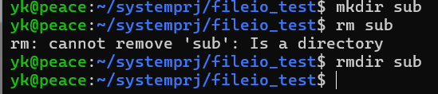
Commands to Create and Delete Directories/ Files
Create directory: mkdir <directory>
Delete files and directories: rm <path>
rmdir <directory> : delete empty directory
rm –r <directory> : remove directories and their contents recursively

Slide 21
파일 (디렉토리) 접근권한(Permission)
접근권한 (Permission)은 각 파일/디렉토리 속성 정보 중의 하나
소유권 (Ownership)
사용자 (Owner) 소유권
그룹 (Group)소유권
접근권한 (Permission)
Read/Write/Execute
각 파일/디렉토리의 소유자가 해당 파일/디렉토리 권한을 설정
Owner, Group, Others 로 나누어 권한 설정

Slide 22
File Permission
# Links
$ ls –l
-rw-r—r-- 1 yk staff 276 Jun 15 16:58 main.c
permission
Owner
Group
size
(byte)
modification date
File name
File type
char | file type description
- | Regular file
d | Directory
b | Block device
c | Character device
l | Symbolic link
s | Socket
char | Regular file | Directory
- | No permission | No Permission
r | 읽기, 복사하기 | 파일 목록을 읽을 수 있음
w | 수정, 삭제, 이동하기 | 디렉토리내 파일을 생성, 삭제
x | 파일 (프로그램)실행 | 디렉토리로 이동(cd)

Slide 23
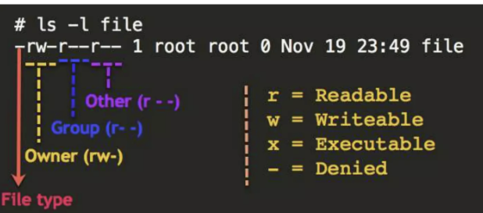
Permissions of Files
Type | read | write | execute | read | write | execute | read | write | execute
d or - | r or - | w or - | x or - | r or - | w or - | x or - | r or - | w or - | x or -
owner
group
others
sample:
File Permission by ls –l command shows 9 characters
-rwxrwxrwx or 3 octal numbers
for the mode arg of open()
user group others
file type
d, l, c, b

Slide 24
File Ownership and Permission Commands
Change owner :
$ chown [option] <new_owner>[:<new_group>] <path>
option: -R
Ex) $ chwon s1234:student *.c (현재위치의 *.c 파일의 사용자와 그룹을 변경함)
Changing permission:
$ chmod <mode> <path>
symbolic or 3 octal numbers
who | operation | Permission
u: owner g : group o: others a: all | = : set access + : add access - : remove access | r : read w : write x: execute
owner |  |  | group |  |  | others
r | w | x | r | w | x | r | w | x
binary
1 | 1 | 1 | 1 | 1 | 1 | 1 | 1 | 1
octal
7 | 7 | 7
$ chmod 777 main.c
$ chmod 644 main.c
$ chmod a=rw main.c
$ chmod u+x main.c
$ chmod go-w main.c
r | w | - | r | - | x | r | - | x
binary
1 | 1 | 0 | 1 | 0 | 0 | 1 | 0 | 0
octal
6 | 4 | 4

Slide 25
Masking File Permission
Default File Permission
일반 파일 생성시 : 666
디렉토리, 실행가능한 파일 생성시 : 777
umask
파일 생성시 기본적용되는 파일 권한의 Mask 설정
파일 권한 = Mask XOR Default Permission
예시)
$ umask 022
$ touch myfile
$ ls –l myfile
-rw-r--r-- 0 myfile
기본권한 : 666
xor) Mask : 022
---------------------
파일 권한: 644
기본권한 : 777
xor) Mask : 066
---------------------
파일 권한: 711

Slide 26
특수 접근권한
8진수 4자리로 권한 설정시 맨앞자리는 특수 접근 권한 의미
맨앞자리 8진수 숫자
0: 나머지 세자리로 일반 권한 설정
1: SetUID – 실행화일에 설정되어 파일 소유자 권한으로 실행
2: setGID – 디렉토리에 설정되어 디렉토리 그룹 권한으로 파일 생성
4: sticky bit – 주로 공유디렉토리에 사용됨

Slide 27
UID vs. EUID
UID (User ID)
실제 사용자 ID (RID)
Login ID
EUID (Effective UID)
유효 사용자 ID
현재 명령을 실행하는 주체의 UID
일반적으로 UID == EUID
passwd 명령어는 root만이 접근 가능한 파일(/etc/shadow)을 접근해야 함. passwd 명령어 실행시, UID는 일반 사용자이지만 EUID는 root (root 권한으로 실행)
su (switch user) 명령어는 로그아웃 없이 다른 사용자 권한을 가짐
현재 UID 확인
who (login한real user id 확인)
whoami (effective user id 확인)
UID
EUID
yk
kkim
yk
su kkim
kkim

Slide 28
SetUID
해당 파일이 실행되는 동안 파일 소유자의 권한으로 실행되도록 설정
예시
chmod 4755 (u+s) 적용된 예
ls –l /usr/bin/passwd
/usr/bin/passwd가 접근하는 화일들
/etc/passwd : 일반 사용자는 읽기만 가능
/etc/shadow : 일반 사용자는 읽기 및 변경 불가능 (root 권한 필요)
ls –l /etc/passwd /etc/shadow
Notes:
# 일반 사용자가 passwd 명령어를 실행해도, root 권한으로 /etc/shadow 수정 가능

Slide 29
SetGID
해당 파일이 실행되는 동안 파일 그룹의 소유자의 권한으로 실행되도록 설정
주로 디렉토리에 설정됨
setGID가 설정된 디렉토리에 사용자가 파일을 생성하면 사용자의 소속 그룹에 무관하게 그 디렉토리 소유 그룹 권한으로 생성됨
Chmod 2755 testFile (g+s)
-rwxr-sr-x
Notes:
# 프로젝트 디렉토리 생성 후 setGID 설정
mkdir /shared_project
chgrp developers /shared_project
chmod g+s /shared_project
# 이제 /shared_project에 파일을 만들면
# 자동으로 그룹이 'developers'가 됨
touch /shared_project/test.c
ls -l /shared_project/test.c
-rw-r--r-- 1 user developers 0 Aug 25 12:00 test.c

Slide 30
Sticky bit
Sticky bit가 설정된 Directory는 누구나 파일을 자기 소유로 생성가능
다른 사용자는 내가 만든 파일을 수정할 수 없음
/tmp : root 소유의 디렉토리, 누구나 파일 생성 가능, 다른 사용자가 생성한 파일은 삭제 불가
적용예
chmod 1777 (o+t)
ls –ld /tmp

Slide 31
File Types in the Linux System
The file types in Linux referred to as normal files and directories are also familiar to other operating systems
Normal Files
Directories
Additional types of files are UNIX-specific
Device Files
Links
Sockets
Pipes and FIFOs

Slide 32
Link Files
Each file is described by an inode
To see the inode number you an enter ls –i
Each inode has a size of 128 bytes
An inode contains all the information about the file besides filename
Link: a reference to a file
Create a Hard Link using ln, which points to the inode of an already existing file
hard links can only be used when both file and the link are in the same file system
Create a Symbolic Link using ln –s; a symbolic link is assigned its own inode
Original and Link has different inode
Using symbolic Link, you can create link to directories (Hard Link is not allowed for directory)

Slide 33
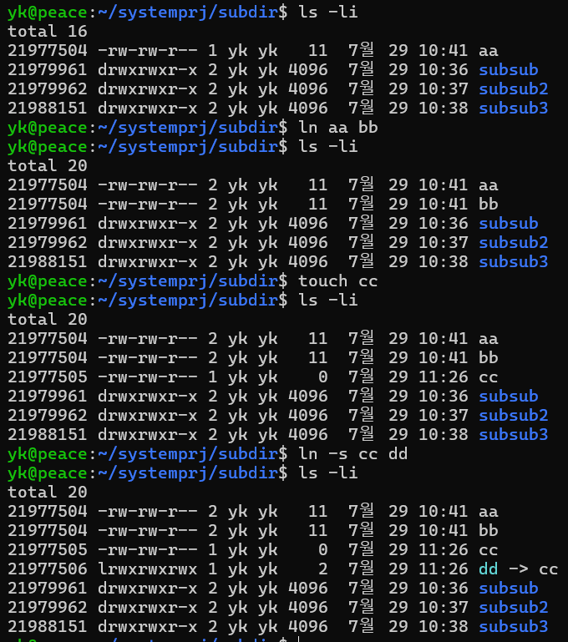
Link Example
make link with ln command
check with ls –i command

Slide 34
Find Files
find <path> -name <patterns>
find / -name game : looks for a file named ‘game’ starting / directory
find /home –user joe : find every files under the directory /home owned by joe
find /usr –name *stat : find every files under the directory /usr ending ‘stat’
locate <pattern>
alternative to find –name
locate <pattern>
package findutils-locate must be installed
searches through database previously created (/var/lib/located), making it faster (database is daily updated automatically or manually by updated)
whereis <command>:
returns binary (-b), sourcecode (-s) or manual (-m) for the specified command
which <command>
searches all the paths listed in the variable PATH for the specified command and returns the full path of specified command

Slide 35
Filesystem Commands Summary
cd
pwd
ls
cp
mv
rm
rmdir
rmdir
touch
cat
less/more
head
tail
ln

Slide 36
Managing Linux Files and Directories
HGU

Slide 37
UNIX File System Hierarchy
UNIX File System is Logical Method of Organizing and Storing Large Amount of Information
A file is a smallest unit in which the information is stored.
All data in UNIX organized into files.
All files are organized into directories.
Linux Files are stored in a single rooted, hierarchical file system
Linux Places all the partitions under the root directory by ‘mounting’ them under specific directories.

Slide 38
FHS
Filesystem Hierarchy Standard (FHS) defines the directory structure and directory contents in Linux and Unix-like operating systems.
It provides guidelines for how directories should be organized and what types of files should be placed in each directory.
It is maintained by the Linux Foundation and helps standardize the location of system files across different Linux distributions
FHS objectives
the goal of FHS is to maintain consistency across various Linux distributions, making it easier for system administrators and users to navigate the file system and manage their systems effectively.

Slide 39
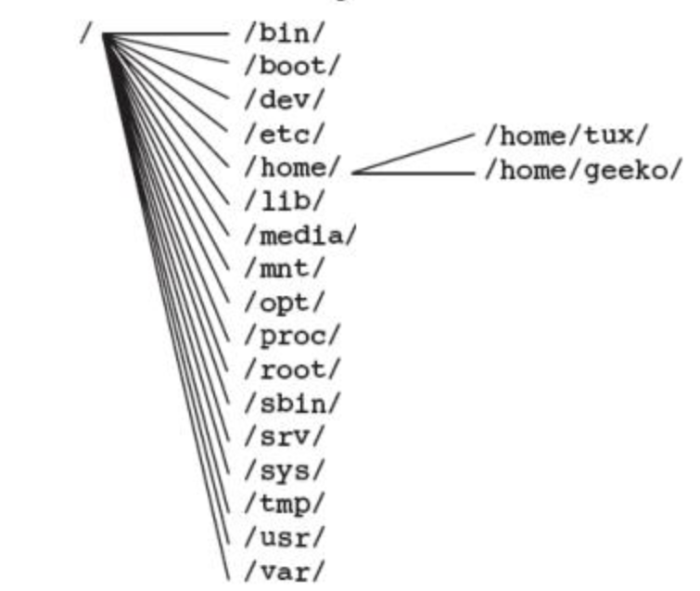
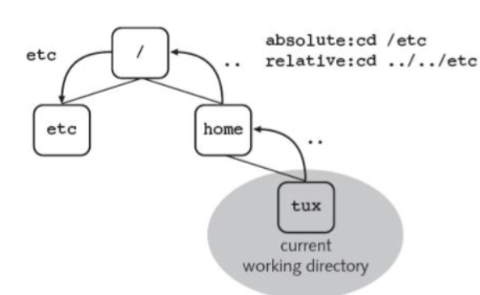
The Hierarchical Structure of FHS
current
working directory
relative path vs. absolute path

Slide 40
Understanding Linux File System Hierarchy
Root Directory (/)
Essential Binaries for Use by All users (/bin/)
Boot Directories (/boot/)
Device Files (/dev/)
Configuration Files (/etc/)
User Directories (/home/)
Libraries (/lib/)
Mount Points for Removable Media (/media/*)
Application Directory (/opt/)
Home Directory of the Administrator (/root/)
System Binaries (/sbin/)
Data Directories for Services (/srv/)
Temporary Area (/tmp/)
user-space programs and files that are not essential for boot (/usr/)
Variable Files (/var/)
Process Files (/proc/)
System Information Directory (/sys/)
Mount Point for Temporarily Mounted File Systems (/mnt/)

Slide 41
Root Directory (/)
The root directory refers to the highest layer of the file system tree
Only directories are located here, not files
When the system is booted, the partition on which root directory is located is the first one mounted
All programs that are run on the system start must be available on this partition
The following directories always have to be on the same partition as the root directory:
/bin/, /sbin/, /lib/, /dev/, /root/, and /sys/
Essential for system boot, initialization, and emergency recovery
Notes:
certain directories should typically reside on the same partition as the root (/) because they are essential for system boot, recovery, and basic functionality. These directories contain critical files that are necessary for the system to operate properly during boot, system initialization, and emergency recovery.

Slide 42
/bin/ : Essential Binaries for Use by all Users
/bin/bash : the bash shell
/bin/cat : display files
/bin/cp : copy files
/bin/dd : low-level copy files byte-wise
/bin/gzip : compress files
/bin/mount : Mount file systems
.bin/rm : delete files
/bin/vi : vi editor

Slide 43
/lib/ (Libraries)
contains Essential Shared Libraries that are required by the system for booting and running the core functionalities.
These libraries are used by the binaries located in /bin and /sbin to function properly.
Common Files in /lib
libc.so : C Libaray
libm.so : math library
Kernel modules: /lib/modules that are peace of codes loaded into kernel as needed to support hardware
/lib64: contains libraries specifically for 64-bit binaries
Libraries for user-installed applications are generally found in /usr/lib or /usr/local/lib, which are not critical for booting or system recovery.

Slide 44
Mounting a File Systems
mounting refers to the process of making a file system accessible at a certain point in the directory structure.
A directory must exist at the point where you intend to mount the file system
This directory is referred to as the mount point
Mounted file system does not have to be on a local hard disk
Use mount and umount commands
If you mount a file system to a non-empty directory, existing contents of directory will not be accessible
In most cases, only the user root can mount and unmount directories

Slide 45
Mount Point for Temporarily Mounted File Systems (/mnt/)
Standard directory for integrating file systems
It should only be used for temporary purposes
# mount /dev/hda7 /mnt
# umount /mnt
To specify a specific file system, use the option -t
If the file system format is not supported by the kernel, the command is aborted
mount -t <file_system_type> <device> <mount_point>
<file_system_types> : ext4 (4th Linux filesystem), vfat (FAT32 used for windows and USB), ntfs (Windows NTFS), iso9660 (CDROM), nfs (Network file system), tmpfs
If you do not include any options with mount, the program tries out several file system formats

Slide 46
Directories for Mounting Other File Systems (cont’d)
The directories that cannot be imported from other machines (machine-specific and directly tied to the local machine's hardware)
Some of the directories that can be shared are:
Directory | Description
/bin/ | important programs
/boot/ | kernel and boot files
/dev/ | device files
/etc/ | configuration files
/lib/ | libraries
/sbin/ | important programs for system administration
Directory | Description
/home/ | Home directories
/opt/ | Applications
/usr/ | The hierarchy below /usr/

Slide 47
Mount Point for Removable Media (/media/)
The /media directory is designated for mounting removable media like CDs, DVDs, USB drives, SD cards, and external hard drives
On modern Linux systems, when a user inserts a USB drive or CD/DVD, the system typically automatically mounts the device under /media/, often creating a subdirectory with the name of the device or label:
/media/cdrom/
/media/usb/
/media/dvd/

Slide 48

Automated Mounting Filesystems
Automated mounting when booting
use /etc/fstab
Example of /etc/fstab Entry
/dev/sda1 : device to be mounted
/mnt/data : The directory of mount pont
ext4 : file system type
default: mount option (rw, suid, dev, exec, auto, nouser, async)
0 : No dump backup
2: Enable file system check (fsck) for non-root partition at boot

Slide 49
Appendix Linux FHS Details

Slide 50
Boot Directory (/boot/)
/boot/ contains static files of the boot loader
These are files required for the boot process (with the exception of configuration files)
The backed-up information for the Master Boot Record (MBR) and the system map files are also stored here
These contain information about where exactly the kernel is located on the partition
This directory also contains the kernel
According to FHS, the kernel can also be located directly in the root directory

Slide 51
Configuration Files (/etc/)
File | Description
/etc/SuSE-release | version number of the installed SUSE Linux Enterprise Server
/etc/inittab | Configuration file for the init process
/etc/init.d/* | scripts for starting services
/etc/grub.conf | configuration file of GRUB
/etc/modprobe.conf | configuration file of kernel modules
/etc/DIR_COLORS | Specifies the colors of ls
/etc/X11/XF86Config | Configuration file of the X windows System
/etc/fstab | Table of the file systems automatically mounted at system start
/etc/passwd | User database; all information except passwords
/etc/shadow | Encrypted passwords of users
/etc/group | Database of user group
/etc/cups/* | Files for CUPS printing system
/etc/hosts | Allocation of computer names to IP address
/etc/motd | Welcome message adter a user logs in (message of the day)
/etc/issue | Linux Welcome message before the logic prompt

Slide 52
Device Files (/dev/)
Each hardware component existing in the system is represented as a file in /dev/
The hardware components are addressed via these files by writing or reading to or from one of the files.
Two types of Device Files Exist:
Character special files (or character devices)
‘talks’ to device character-by-character (1 byte at a time)
Examples: printer, virtual terminals, serial devices
Block special files (or block devices)
‘talks’ to device 1 block at a time (1 block can be 512bytes to 312KB)
Examples: Hard disk, floppy disk, CD burners.

Slide 53
Device Files (/dev/, cont’d)
Device | Device Files | Description
Terminal | /dev/console /dev/tty1 | The system console The first virtual console, reachable by pressing Ctrl+ALT+F1
Serial ports | /dev/ttyS0 /dev/ttyS* | the first serial port
Parallel ports | /dev/lp0 /dev/lp* | the first parallel port
Floppy disk drive | /dev/fd0 /dev/fd* | the first floppy disk drive. If the drives are addressed via the device file fd0 and fd1, the kernel tries to recognize the floppy disk format itself
IDE hard drive | /dev/hda /dev/hdc /dev/hd* | the first IDE hard drive on the first IDE controller the first IDE hard drive on the second IDE controller To label the partitions, the device names are given number. Number 1 to 4 refer to primary partitions, higher numbers to logical partitions. Example: /dev/hda1 is the first primary partition on the first IDE hard drive

Slide 54
Device Files (/dev/, cont’d)
Device | Device File | Description
IDE CD-ROM/DVD drive | /dev/hd* | The drives are named in the same way as the IDE hard drivers. This means that the CD-ROM/DVD drive /dev/hdd is the second drive on the second IDE controller
SCSI hard drives | /dev/sda /dev/sda* | the first SCSI hard drive With SCSI hard drives, the device names are given numbrs to label the various partitions. For example, /dev/sda1 is the first primary partition on the first SCSI hard drive
SCSI CD-ROM/DVD | /dev/scd0 /dev/scd* | The first SCSI CD-ROM/DVD drive

Slide 55
System Binary (/sbin/)
Contains important system administration programs
Programs in /sbin/ can also, as a rule, be run by normal users, but only to display configured values
File | Description
/sbin/conf.d/* | contains more scripts from SuSEconfig family; they are called up by /sbin/SuSEconfig
/sbin/yast | Administration tool for SUSE Linux Enterprise Server
/sbin/fdisk | Modifies partitions
/sbin/fsck | Checks file systems (file system check)
/sbin/init /sbin/mkfs | initializes the system creates a file system (formatting)
/sbin/shutdown | shut down the system

Slide 56
Regular User Directories (/home/)
Every user on a Linux system has his own area in which to create and remove files: its home directory
Individual configuration files can be found in the user’s home directory
.profile : user’s private logic script
.bashrc : configuration file for bash
.bash_history : List of commands previously run in bash
If there are no special settings, the home directories of all users are located beneath /home/
The home directory of a user be addressed via “~”

Slide 57
Home Directory of the Administrator (/root/)
The home directory of the system administrator is not located beneath /home/ like that of a normal user
Preferably, it should be on the same partition as the root directory,“/”
Only then is it guaranteed that the user root can always log in without a problem and have her own configured environment available

Slide 58
Temporary Area (/tmp/)
Directory used for temporary files that are created by programs, services, and users
Not meant to persistent beyond a short period of time
Auto cleaning : cleared at boot or after a certain period of inactivity
Volatile Storage: /tmp is mounted as tmpfs meaning contents reside in RAM
It is world-writable, meaning that all users can create and delete files in /tmp. To maintain security, the sticky bit is set on /tmp, meaning that although any user can create files in /tmp, they can only delete their own files.
Sticky Bit (represented by t in the file permissions) prevents users from deleting or modifying other users' files in /tmp. For example, the permissions for /tmp might look like this:

Slide 59
The Hierarchy below /usr/ (Unix System Resources)
contains user applications, utilities, and system libraries that are not essential for booting the system but are necessary for normal multi-user operations.
Directory | Description
/usr/X11R6 | FIles of X Window System
/usr/bin/ | Almost all executable programs not essential for booting the Linux
/usr/lib/ | Libraries
/usr/local/ | Locally installed programs, now frequently found in the directory /opt/
/usr/sbin/ | Programs for system administration
/usr/share/doc/ | Documentation
/usr/share/man | The manual pages (command descriptions)
/usr/src/ | SOurce files of all programs and the kernel (if installed)
Notes:
/usr is where most user-space programs and applications reside.
While essential system files live in /bin and /lib, more complex software is stored under /usr.

Slide 60
Variable Files (/var/)
Contains files that can be modified while the system is running
Data that changes
Growing data : log, spooled data, cache data
Exmaple)
/var/spool : printer queue or mail queue waiting for later process
/var/cache : cached data (previously computed or downloaded file to reuse)
/var/tmp : temporary that need to persist between reboots
/var/log : log files generated by system and services (/var/log/syslog)
/var/lib : stores dynamic data related to the state of applications
/var/lock : lock files to prevent multiple concurrent processes to the same resource
Persistent data: Unlike /tmp, which is cleared when rebooting, many files in /var remains across reboot

Slide 61
Data Directories for Services (/svc/)
The directory /srv/ contains subdirectories filled with data of various services
For example:
The files of the Apache web server are located in the directory /srv/www/
The FTP server files are located in the directory /srv/ftp/

Slide 62
System Information Directory (/sys/)
The /sys directory is a virtual filesystem created and managed by the Linux kernel. It represents system and hardware information, including devices, drivers, and kernel settings.
Real-time System information and allows both reading hardware states and, writing to modify system behavior or configure devices.
The files and directories within /sys are not regular files but are instead interfaces to kernel data structures, allowing user applications to interact with the system at a lower level.
(Example 1) You can adjust the brightness of a laptop's backlight by writing to /sys/class/backlight/acpi_video0/brightness.
(Example 2) /sys/devices/system/cpu/cpu0/cpufreq/scaling_cur_freq shows the current CPU frequency.
(Example 3) /sys/class/net/eth0/address: displays the MAC address of the network interface.

